Slide 1


Hasan Hammad
09, September, 2023

Slide 2


Outline
Executive Summary
Introduction
Methodology
Results
Conclusion
Appendix

Slide 3
Executive Summary
Summary of methodologies
Data collection
Data wrangling
Exploratory Data Analysis with Data Visualization
Exploratory Data Analysis with SQL
Building an interactive map with Folium
Building a Dashboard with Plotly Dash
Predictive analysis (Classification)

Slide 4

Executive Summary
Summary of all results
Exploratory Data Analysis results
Interactive analytics demo in screenshots
Predictive analysis results

Slide 5
Introduction
Project background and context
SpaceX stands out as the preeminent achiever in the era of commercial space exploration, playing a pivotal role in democratizing space travel. On its website, the company showcases Falcon 9 rocket launches, priced at a competitive $62 million per launch, a stark contrast to other providers whose charges exceed a staggering $165 million for each mission. A significant portion of this cost disparity stems from SpaceX's pioneering ability to recover and reuse the first stage of its rockets. Consequently, the ability to ascertain the successful landing of the first stage serves as a key determinant for launch cost estimation. Leveraging publicly available data and advanced machine learning algorithms, we endeavor to forecast the likelihood of SpaceX reusing the first stage in future missions.

Slide 6

Introduction
Questions to be answered
How do variables such as payload mass, launch site, number of flights, and orbits affect the success of the first stage landing?
Does the rate of successful landings increase over the years?
What is the best algorithm that can be used for binary classification in this case?

Slide 7

Section 1

Slide 8

Methodology
Executive Summary
Data collection methodology:
Describe how data was collected
Using SpaceX Rest API
Using Web Scrapping from Wikipedia
Perform data wrangling
Describe how data was processed
Filtering the data
Dealing with missing values
Using One Hot Encoding to prepare the data to a binary classification

Slide 9

Methodology
Executive Summary
Perform exploratory data analysis (EDA) using visualization and SQL
Perform interactive visual analytics using Folium and Plotly Dash
Perform predictive analysis using classification models
Building, tuning and evaluation of classification models to ensure the best results

Slide 10
Data Collection
The data collection process encompassed a dual approach, utilizing both API requests from SpaceX's REST API and web scraping techniques to extract data from a table within SpaceX's Wikipedia entry. This combined methodology was essential to obtain comprehensive information about their launches, enabling a more thorough and detailed analysis.
Data Columns are obtained by using SpaceX REST API:
FlightNumber, Date, BoosterVersion, PayloadMass, Orbit, LaunchSite, Outcome, Flights, GridFins, Reused, Legs, LandingPad, Block, ReusedCount, Serial, Longitude, Latitude
Data Columns are obtained by using Wikipedia Web Scraping:
Flight No., Launch site, Payload, PayloadMass, Orbit, Customer, Launch outcome, Version Booster, Booster landing, Date, Time

Slide 11

GitHub URL: Data Collection API
Data Collection – SpaceX API
Requesting rocket launch data from SpaceX API
Decoding the response content using .json() and turning it into a dataframe using .json_normalize()
Requesting needed information about the launches from SpaceX API by applying custom functions
Constructing data we have obtained into a dictionary
Exporting the data to CSV
Replacing missing values of Payload Mass column with calculated .mean() for this column
Filtering the dataframe to only include Falcon 9 launches
Creating a dataframe from the dictionary

Slide 12
Data Collection - Scraping
GitHub URL: Web Scraping Notebook
Requesting Falcon 9 launch data from Wikipedia
Creating a BeautifulSoup object from the HTML response
Extracting all column names from the HTML table header
Collecting the data by parsing HTML tables
Exporting the data to CSV
Creating a dataframe from the dictionary
Constructing data we have obtained into a dictionary

Slide 13
Data Wrangling
GitHub URL: Data Wrangling
Perform exploratory Data Analysis and determine Training Labels
In the dataset, there are various scenarios where the booster's landing was not successful. These instances can be categorized based on different criteria. For instance, "True Ocean" indicates a successful landing in a specific oceanic region, while "False Ocean" signifies an unsuccessful landing in the ocean. Similarly, "True RTLS" denotes a successful landing on a ground pad, whereas "False RTLS" indicates an unsuccessful ground pad landing. Lastly, "True ASDS" represents a successful landing on a drone ship, while "False ASDS" corresponds to an unsuccessful drone ship landing.
To streamline these outcomes for analysis, we have translated them into training labels. A label of "1" signifies a successful landing, while “0" denotes an unsuccessful landing.
Calculate the number of launches on each site
Calculate the number and occurrence of each orbit
Calculate the number and occurrence of mission outcome per orbit type
Create a landing outcome label from Outcome column
Exporting the data to CSV

Slide 14
EDA with Data Visualization
GitHub URL: Data Visualization
We generated a series of charts to visually represent the data:
Flight Number vs. Payload Mass, Flight Number vs. Launch Site, Payload Mass vs. Launch Site,Orbit Type vs. Success Rate, Flight Number vs. Orbit Type, Payload Mass vs. Orbit Type, Success Rate Yearly Trend
Scatter plots within these charts help uncover potential relationships between variables, which could be invaluable in constructing machine learning models.
Bar charts were also employed to facilitate comparisons between discrete categories. These charts aim to elucidate the connection between specific categories being compared and the corresponding measured values.
Furthermore, line charts were utilized to track data trends over time, providing a time-series perspective on the information.

Slide 15
EDA with SQL
GitHub URL: EDA with SQL
Conducted SQL queries encompassing various aspects of the space mission data:
Retrieving the names of unique launch sites involved in the space mission.
Displaying five records where launch sites commence with the string 'CCA.'
Calculating the total payload mass transported by boosters launched under NASA's CRS program.
Determining the average payload mass carried by boosters of the F9 v1.1 version.
Listing the date when the initial successful ground pad landing outcome was achieved.
Enumerating the names of boosters that achieved success on drone ships, with payload masses ranging from 4000 to 6000.
Providing a tally of the total number of successful and failed mission outcomes.
Identifying the booster versions responsible for transporting the maximum payload mass.
Listing the unsuccessful landing outcomes on drone ships, including the booster versions and launch site names, specifically for the months within the year 2015.
Ranking the count of landing outcomes Failure or Success between the dates 2010-06-04 and 2017-03-20 in descending order.

Slide 16
Build an Interactive Map with Folium
GitHub URL: Folium Map
Summary of Map Markers and Distances Visualization:
Markers for All Launch Sites: We incorporated markers on the map to represent various launch sites. Specifically, we added markers for the NASA Johnson Space Center with circle indicators, popup labels, and text labels, using its latitude and longitude coordinates as the starting point. Additionally, we included markers for all other launch sites, each marked with circles, popup labels, and text labels, highlighting their geographical positions in relation to the Equator and nearby coastlines.
Colored Launch Outcome Markers: To provide insights into launch outcomes, we introduced colored markers. Successful launches are denoted by green markers, while unsuccessful ones are marked in red. The use of Marker Clusters aids in identifying launch sites with higher success rates based on the clustering of green markers.
Distance Visualization: We enhanced the visualization by adding colored lines that display distances between the KSC LC-39A launch site (as an example) and its proximity points, such as railways, highways, coastlines, and the nearest city. These lines help viewers understand the spatial relationships between the launch site and its surroundings.

Slide 17
Build a Dashboard with Plotly Dash
GitHub URL: Dashboard
Summary of the Dashboard
Launch Sites Dropdown List: Implemented a convenient dropdown list feature, allowing users to select their preferred launch site effortlessly.
Pie Chart for Launch Success: Introduced an informative pie chart to visualize the overall count of successful launches across all sites. Moreover, if users opt for a specific launch site, the chart dynamically displays the success versus failure counts for that particular site, providing valuable insights at a glance.
Payload Mass Range Slider: Incorporated a user-friendly slider control that enables users to specify the desired payload mass range, enhancing the precision of data exploration.
Scatter Chart for Payload vs. Success Rate: Introduced a scatter chart to depict the relationship between payload mass and launch success rate across different booster versions. This visualization aids in identifying potential correlations and patterns within the data.

Slide 18
Predictive Analysis (Classification)
GitHub URL: Classification
Creating a NumPy array from the column “Class” in data
Standardizing the data with StandardScaler, then fitting and transforming it
Splitting the data into training and testing sets with train_test_split function
Creating a GridSearchCV object with cv = 10 to find the best parameters
Finding the method performs best by examining the Jaccard_score and F1_score metrics
Examining the confusion matrix for all models
Calculating the accuracy on the test data using the method .score() for all models
Applying GridSearchCV on LogReg, SVM, Decision Tree, and KNN models

Slide 19

Results
Exploratory data analysis results
Interactive analytics demo in screenshots
Predictive analysis results

Slide 20

Section 2

Slide 21
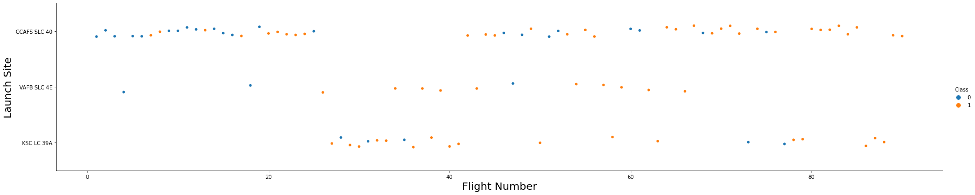
Flight Number vs. Launch Site
Explanation:
The initial flights in the dataset experienced a series of failures, while the most recent flights achieved success. This suggests an improvement in mission outcomes over time.
The CCAFS SLC 40 launch site accounts for approximately half of all launches, indicating its significance in the space mission program.
Two specific launch sites, VAFB SLC 4E and KSC LC 39A, stand out with notably higher success rates compared to others. This underscores their effectiveness and reliability.
There's a plausible assumption that each new launch in the dataset is associated with a higher likelihood of success, given the historical progression from failures to successes.

Slide 22
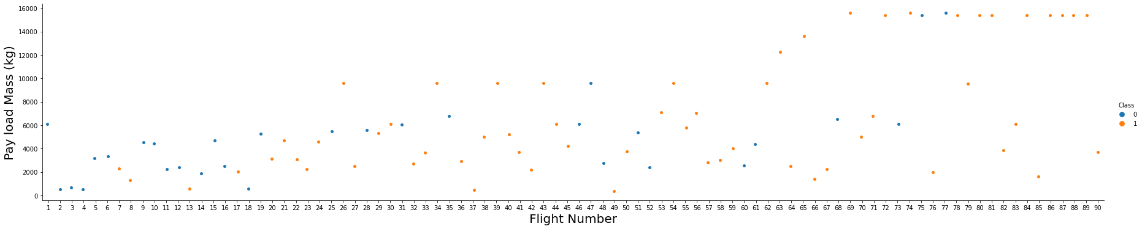
Payload vs. Launch Site
Explanation:
For every launch site the higher the payload mass, the higher the success rate.
Most of the launches with payload mass over 8000 kg were successful.

Slide 23
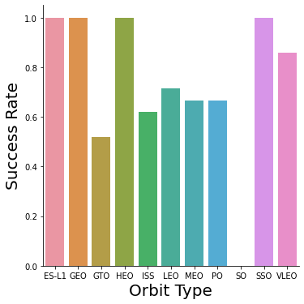
Success Rate vs. Orbit Type
Explanation:
Orbits with 100% success rate: ES-L1, GEO, HEO, SSO
Orbits with 0% success rate: SO
Orbits with success rate between 50% and 85%: GTO, ISS, LEO, MEO, PO

Slide 24
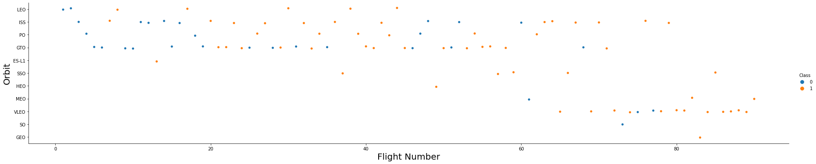
Flight Number vs. Orbit Type
Explanation:
In the LEO orbit the Success appears related to the number of flights; on the other hand, there seems to be no relationship between flight number and orbit type when the orbit is GTO orbit.

Slide 25
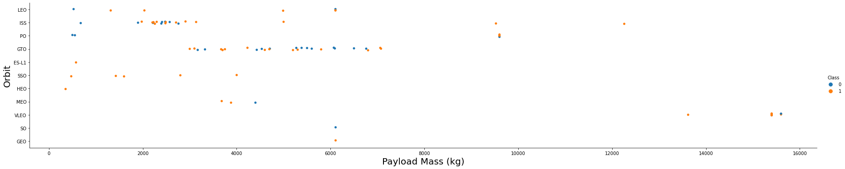
Payload vs. Orbit Type
Explanation:
Payload mass seems to correlate with orbit LEO and SSO seem to have relatively low payload mass
The other most successful orbit VLEO only has payload mass values in the higher end of the range

Slide 26
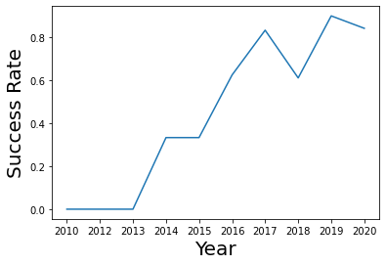
Launch Success Yearly Trend
Explanation:
Success generally increases over time since 2013 with a slight dip in 2018 Success in recent years at around 80%

Slide 27
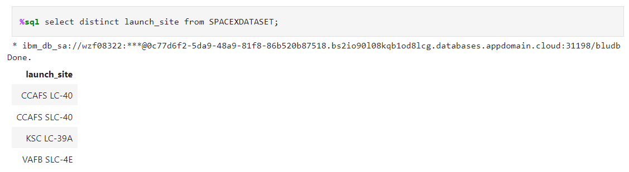
All Launch Site Names
Explanation:
Displaying the names of the unique launch sites in the space mission.

Slide 28
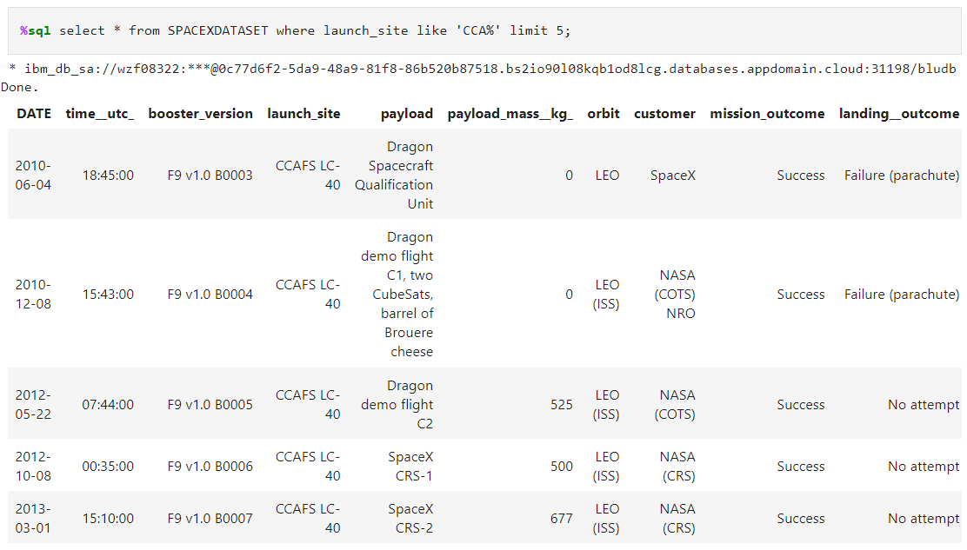
Launch Site Names Begin with 'CCA'
Explanation:
Displaying 5 records where launch sites begin with “CCA”

Slide 29
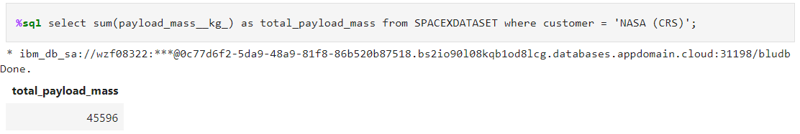
Total Payload Mass
Explanation:
Displaying the total payload mass carried by boosters launched by NASA (CRS).

Slide 30
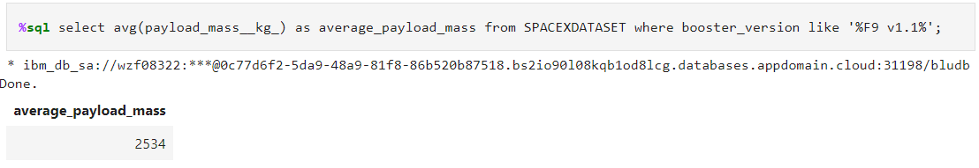
Average Payload Mass by F9 v1.1
Explanation:
Displaying average payload mass carried by booster version F9 v1.1.

Slide 31
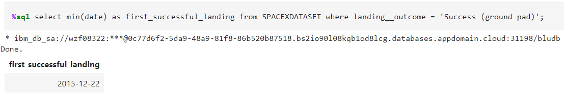
First Successful Ground Landing Date
Explanation:
Displaying the date when the first successful landing outcome in ground pad was achieved.

Slide 32
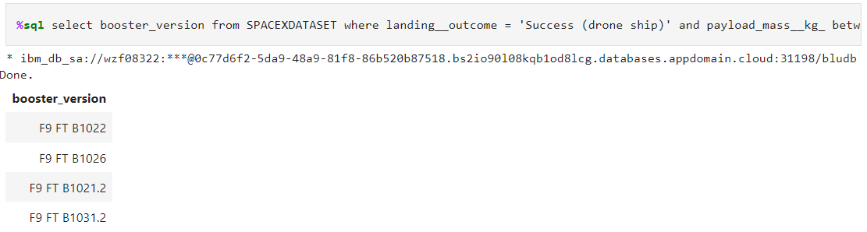
Successful Drone Ship Landing with Payload between 4000 and 6000
Explanation:
Displaying the names of the boosters which have success in drone ship and have payload mass greater than 4000 but less than 6000.

Slide 33
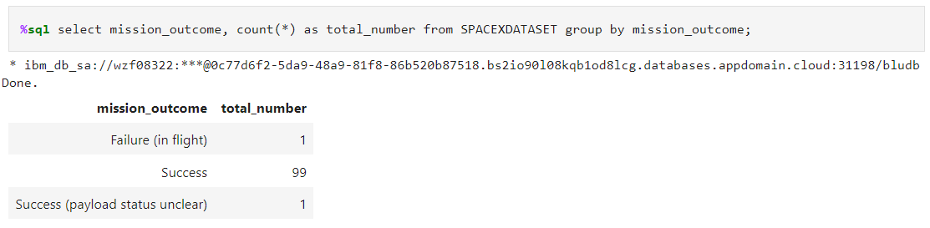
Total Number of Successful and Failure Mission Outcomes
Explanation:
Displaying the total number of successful and failure mission outcomes.

Slide 34
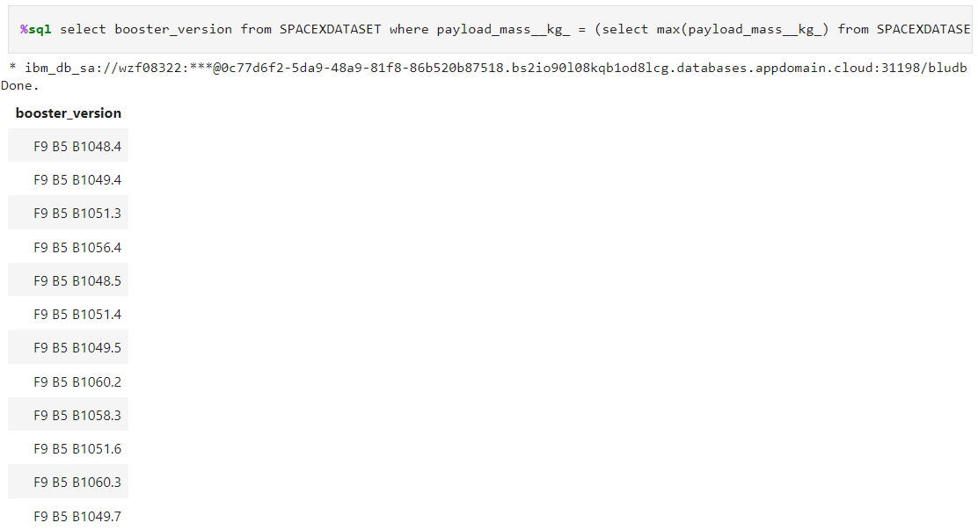
Boosters Carried Maximum Payload
Explanation:
Displaying the names of the booster versions which have carried the maximum payload mass.

Slide 35
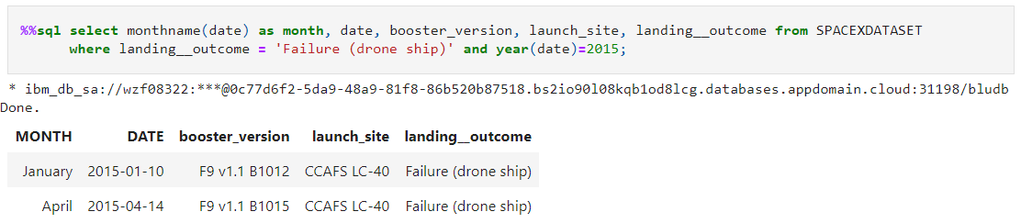
2015 Launch Records
Explanation:
Displaying the failed landing outcomes in drone ship, their booster versions and launch site names for the months in year 2015.

Slide 36
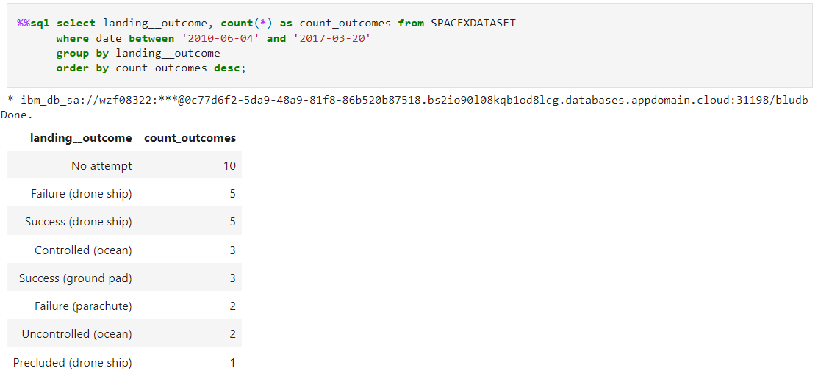
Rank Landing Outcomes Between 2010-06-04 and 2017-03-20
Explanation:
Ranking the count of landing outcomes (such as Failure (drone ship) or Success (ground pad)) between the date 2010-06-04 and 2017-03-20 in descending order.

Slide 37

Section 3

Slide 38
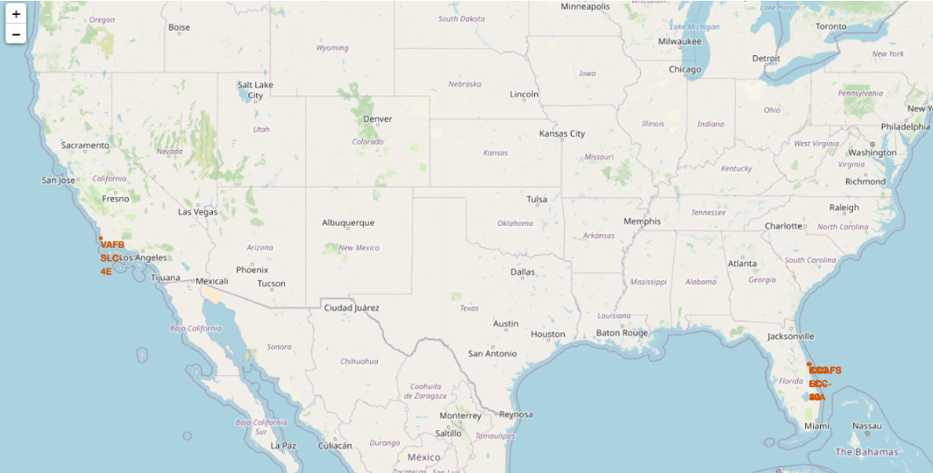
Launch Site Locations
Explanation:
Most launch sites are situated near the Equator due to the region's faster rotational speed. When a spacecraft is launched from this location, it not only ascends into space but also retains its pre-launch velocity. This velocity is crucial for maintaining the necessary speed to stay in orbit.
Furthermore, all launch sites are strategically located in close proximity to coastlines. Launching rockets towards the ocean serves to minimize the potential danger of debris falling or exploding near populated areas.

Slide 39
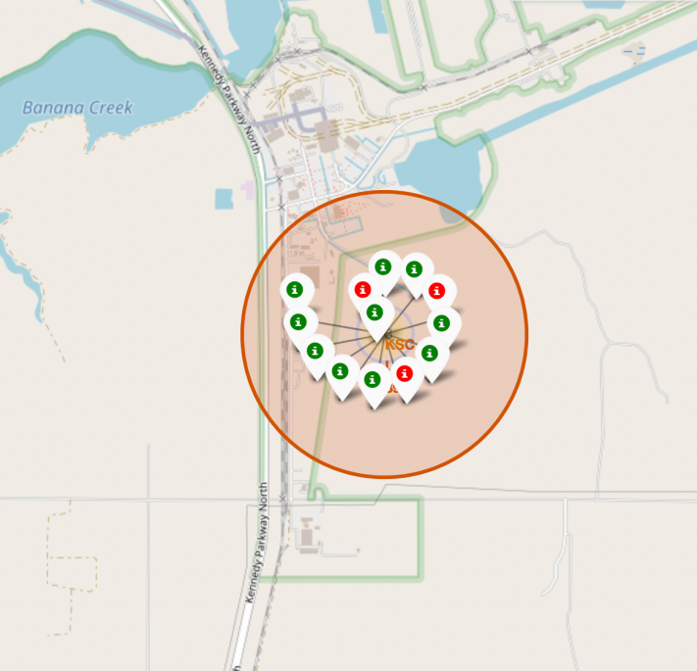
Color-labeled Launch Markers
Explanation:
By referencing color-coded markers, we can readily discern launch sites with notably high success rates. A green marker signifies a successful launch, while a red marker indicates a failed one.
Launch Site KSC LC-39A boasts an exceptionally impressive track record of successful launches.

Slide 40
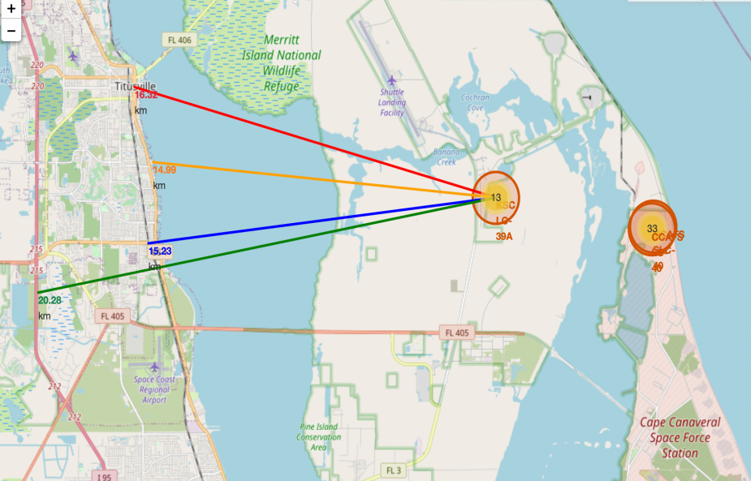
Location Proximities
Explanation:
From the visual analysis of the launch site KSC LC-39A we can clearly see that it is: relative close to railway (15.23 km) - relative close to highway (20.28 km) - relative close to coastline (14.99 km)
Also the launch site KSC LC-39A is relative close to its closest city Titusville (16.32 km).
Failed rocket with its high speed can cover distances like 15-20 km in few seconds. It could be potentially dangerous to populated areas.

Slide 41

Section 4

Slide 42
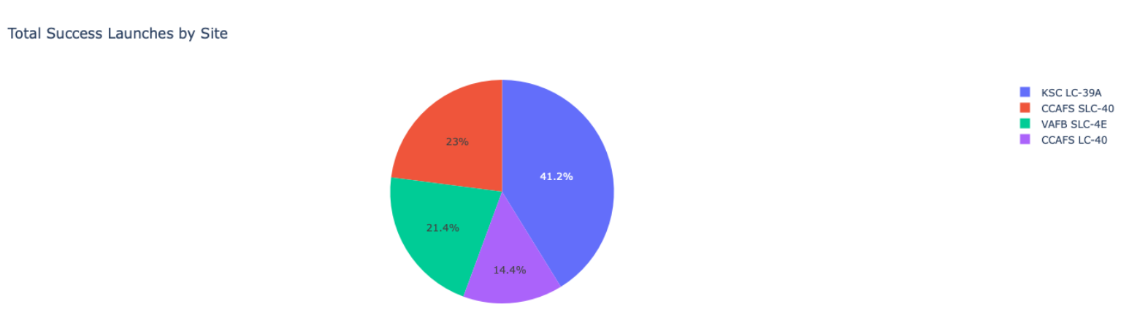
Launch Success Count For All Sites
Explanation:
The chart clearly shows that from all the sites, KSC LC-39A has the most successful launches.

Slide 43
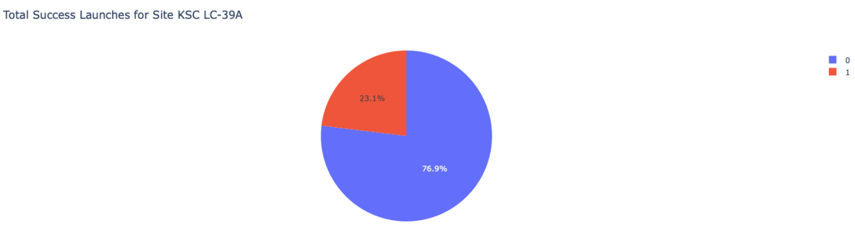
Launch site with highest launch success ratio
Explanation:
KSC LC-39A has the highest launch success rate (76.9%) with 10 successful and only 3 failed landings.

Slide 44
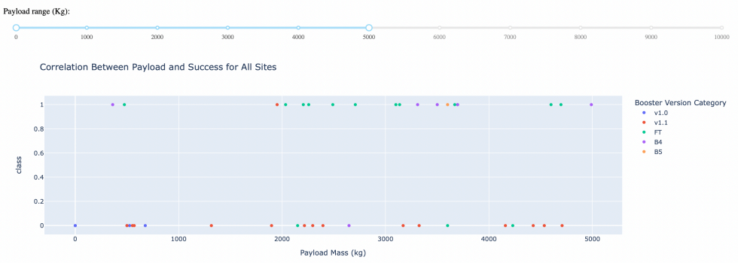
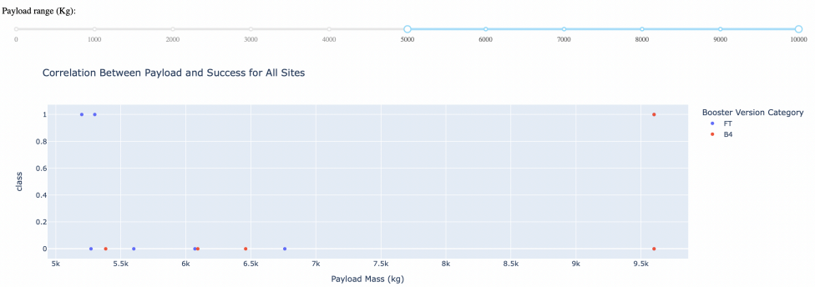
Payload Mass vs. Launch Outcome for all sites
Explanation:
The charts show that payloads between 2000 and 5500 kg have the highest success rate.

Slide 45

Section 5

Slide 46
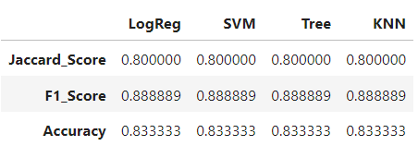
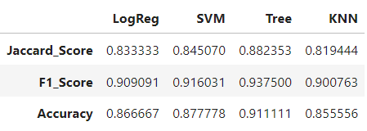
Classification Accuracy
Scores and Accuracy of the Test Set
Scores and Accuracy of the Entire Data Set
Explanation:
Based on the scores of the Test Set, we can not confirm which method performs best.
Same Test Set scores may be due to the small test sample size (18 samples). Therefore, we tested all methods based on the whole Dataset.
The scores of the whole Dataset confirm that the best model is the Decision Tree Model. This model has the highest accuracy.

Slide 47
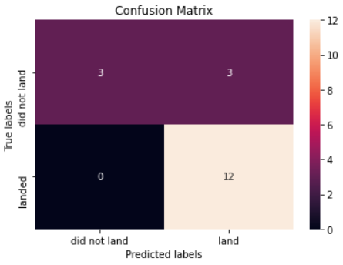
Confusion Matrix
Explanation:
Examining the confusion matrix, we see that logistic regression can distinguish between the different classes. We see that the major problem is false positives.

Slide 48

Conclusions
Decision Tree Model is the best algorithm for this dataset.
Most of launch sites are in proximity to the Equator line and all the sites are in very close proximity to the coast.
The success rate of launches increases over the years.
KSC LC-39A has the highest success rate of the launches from all the sites.
Orbits ES-L1, GEO, HEO and SSO have 100% success rate.

Slide 49

Appendix
GitHub Repository URL
hasanhammad/Applied-Data-Science-Capstone: The final task of this capstone project (github.com)
Special Thanks to All Instructors:
Applied Data Science Capstone - IBM - Course Info | Coursera
SpaceX data
Wikipedia

Slide 50


